Slide 1
Employee Data Analysis using Excel
STUDENT NAME:DHARSHIKA.R
REGISTER NO:312209825
NM ID:DA15D5DB2EFB0DDA0FD406523D794F9D
DEPARTMENT:B.COM ACCOUNTING AND FINANCE
COLLEGE:VALLIAMMAL COLLEGE FOR WOMEN

Slide 2
PROJECT TITLE
Employee Performance Analysis using Excel

Slide 3


AGENDA
Problem Statement
Project Overview
End Users
Our Solution and Proposition
Dataset Description
Modelling Approach
Results and Discussion
Conclusion
3/21/2024 Annual Review

Slide 4

PROBLEM STATEMENT
Employment performance analysis is done in the organization: For his or her increment
To track performance
To focus on the growth of the organisation
To motivate the employee to have Effectiveness

Slide 5

PROJECT OVERVIEW
A project overview for employee data analysis can include the purpose of the project, the tools used, and the phases of the analysis process. For example, a project overview for an HR data analysis project might include:
Purpose: The purpose of the project is to study the HR dataset and use SQL skills Tools.
Microsoft Excel is used for data cleansing, and My SQL is used for data manipulation and exploratory data analysis (EDA) Analysis process: The analysis process phases are ask, prepare, process, analyze, and share.
.

Slide 6

WHO ARE THE END USERS?
Employees
Managers
HR Departments
Organizations

Slide 7

OUR SOLUTION AND ITS VALUE PROPOSITION
Conditional Formatting - To highlight the missing values
Filtering - To remove the missing values
Formula(IFS) - To calculate the employee performance level.
Pivot Table - To summarize.
Graphical representation - For data visualization.

Slide 8
Dataset Description
Employee ID[Numerical values]
First name & last name[text]
Employee status
Employee type
Performance level
Gender
Employee rating
Business unit

Slide 9

THE "WOW" IN OUR SOLUTION
PERFORMANCE LEVEL
=IFS(Z8>=5,"VERYHIGH",Z8>=4,"High",Z8>=3"Medium"True,"Low")
3/21/2024 Annual Review
9

Slide 10
MODELLING
DATA COLLECTION-Download from Kaggle.com
FEATURE SELECTION-The method of reducing the input variable to your model by using only relevant data and getting rid of noise in data.
DATA CLEANING-The process of fixing or removing incorrect, incomplete, or duplicate data in a dataset.
PERFORMANCE LEVEL-Calculate the performance level of employees by considering the current employee rating column
PIVOT TABLE-To summarize the employee analysis
GRAPH: To visualize the data through graphical representation
10

Slide 11
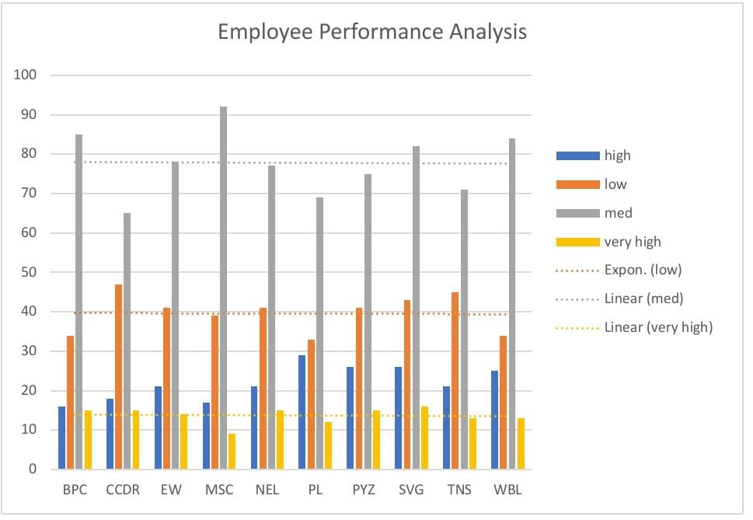
RESULTS
11

Slide 12
conclusion
An employee performance analysis conclusion should summarize an employee's performance during the review period, and highlight their strengths and areas for improvement. The conclusion can also include the employee's relative worth to the organization and their potential for future development.

